Slide 1
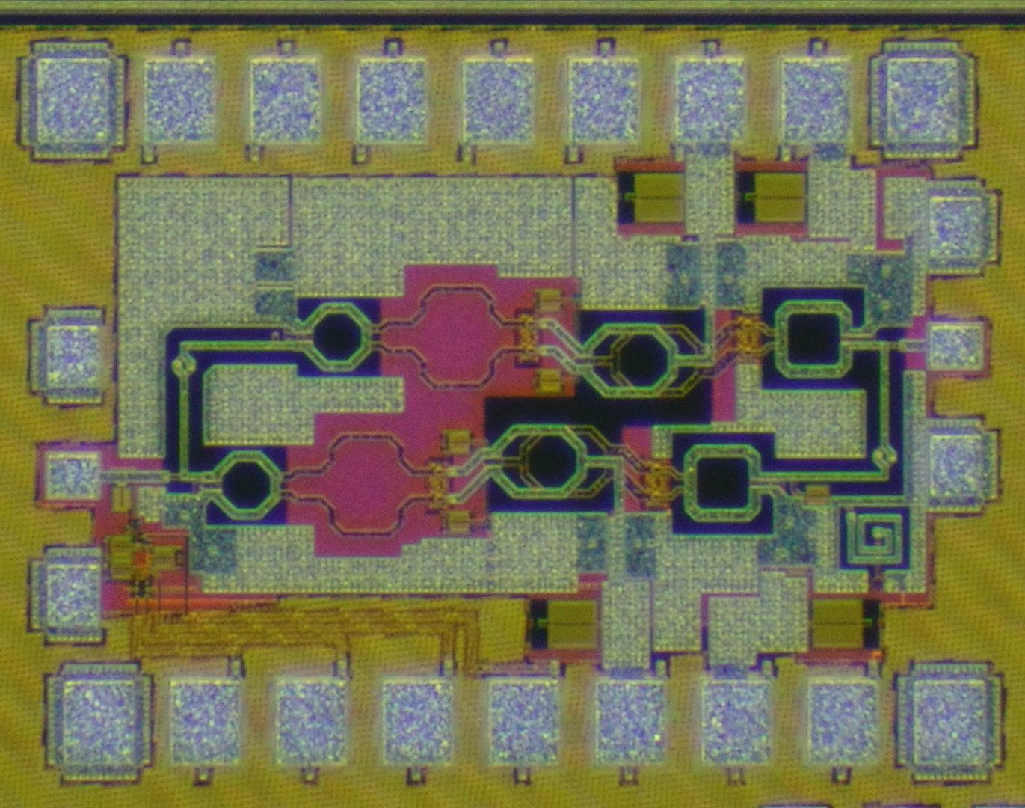
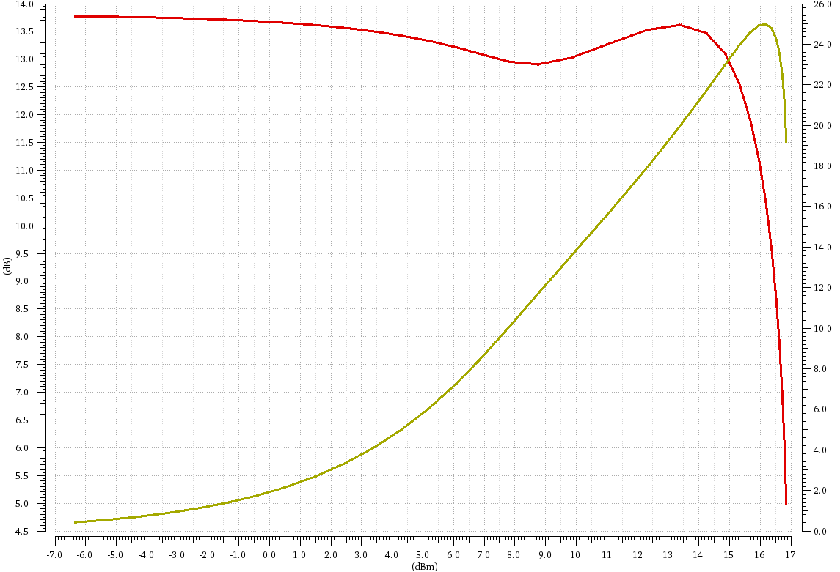
20
V_{var} = -0.25V
15
V_{var} = 1V
10
V_{var} = -1V
5
0
-5
Design of Hybrid Doherty Power Amplifier
using 65nm CMOS technology
Gunwoo Park and Sanggeun Jeon
School of Electrical Engineering, Korea University, Seoul 136-713, Korea
-10
S-parameters (dB)
-15
-20
-25
-30
50
52
54
56
58
60
62
64
66
68
70
Frequency (GHz)
Introduction
Necessity of doherty power amplifier (DPA)
  Efficient technique for back-off efficiency enhancement
  As the modulation schemes get more complex, back-off efficiency of PAs get important
Advantage of hybrid Doherty power amplifier ((Hybrid-DPA)
  The output hybrid coupler make 90 degree phase difference automatically
  The back-off efficiency bandwidth is much wider than conventional DPA
Design
Each transistor cell is composed of two transistors combined for high output power.
By adopting capacitive neutralization, stability and gain are maximized
The gate width of the transistor (wg) was determined by considering the DC power consumption and impedance transform ratio.
To further increase back-off efficiency, adaptive bias network (ABN) is adopted and the DC output of ABN is connected to gate bias of the auxiliary amplifier
Results
In simulation, the PA exhibit a peak gain of 13.7 dB at 61 GHz (V_{var} = -0.25 V)
The saturation output power and peak PAE are simulated at 16.2 dBm and 25 % at 61 GHz
The simulated 6-dB back-off PAE is 14.2 %
20
V_{var} = -0.25V
15
24
15
V_{var} = 1V
10
10
V_{var} = -1V
5
20
5
0
16
0
-5
PAE (%)
-5
0
Gain (dB)
12
-10
-10
S-parameters (dB)
-15
8
-15
-20
-20
-25
4
-25
-30
0
-30
50
52
54
56
58
60
62
64
66
68
70
-7
-5
-3
-1
1
3
5
7
9
11
13
15
17
Frequency (GHz)
P_{out} (dBm)
Conclusion
Hybrid Doherty power amplifier is designed using 65-nm CMOS technology.
Designed Hybrid-DPA has 13.7 dB peak gain and high ratio of PAE and PAE_{6dB} of 0.57.
The chip fabrication and EDA tool were supported by the IC Design Education Center(IDEC), Korea

